Slide 1

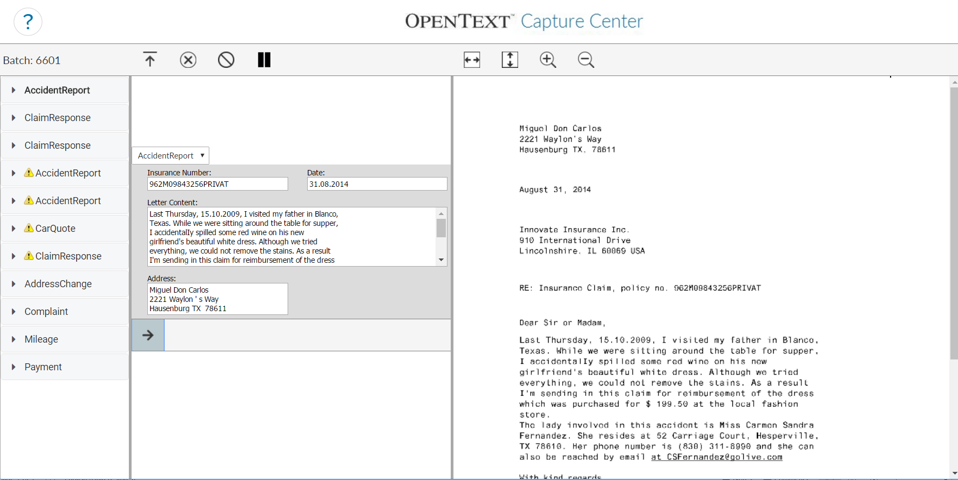
External
data base
Comma separated value file
OCC
data base
Inverted index
OCC validation
(Lookup list)
OCC recognition
(SnapMatch)

